Slide 1
Digital Marketing Project Work
For
Apollo Hospitals

Slide 2



Part 1: Brand study, Competitor Analysis & Buyer’s/Audience’s Persona
COMPANY FOR PROJECT : Apollo Hospital
Research Brand Identity: Apollo hospital provides quality healthcare services with more than branchesacross the country. Prominently Apollo is known best for heart problems and Knee and Hipreplacement surgeries besides other major ailments.
Brand colours:
Saffron, Teal Blue
Logo :
Mission/Values: to bring healthcare of International standards within the reach of every individual. We are committed to the achievement and maintenance of excellence in education, research and healthcare for the benefit of humanity”.
USP: With automated systems for getting appointment, Apollo Hospitals has an efficient method of handling appointments & managing the crowd. Also with the state of art healthcare infrastructure it has the capability to handle the most complex of surgeries.
Tagline : Trusted for our expertise

Slide 3
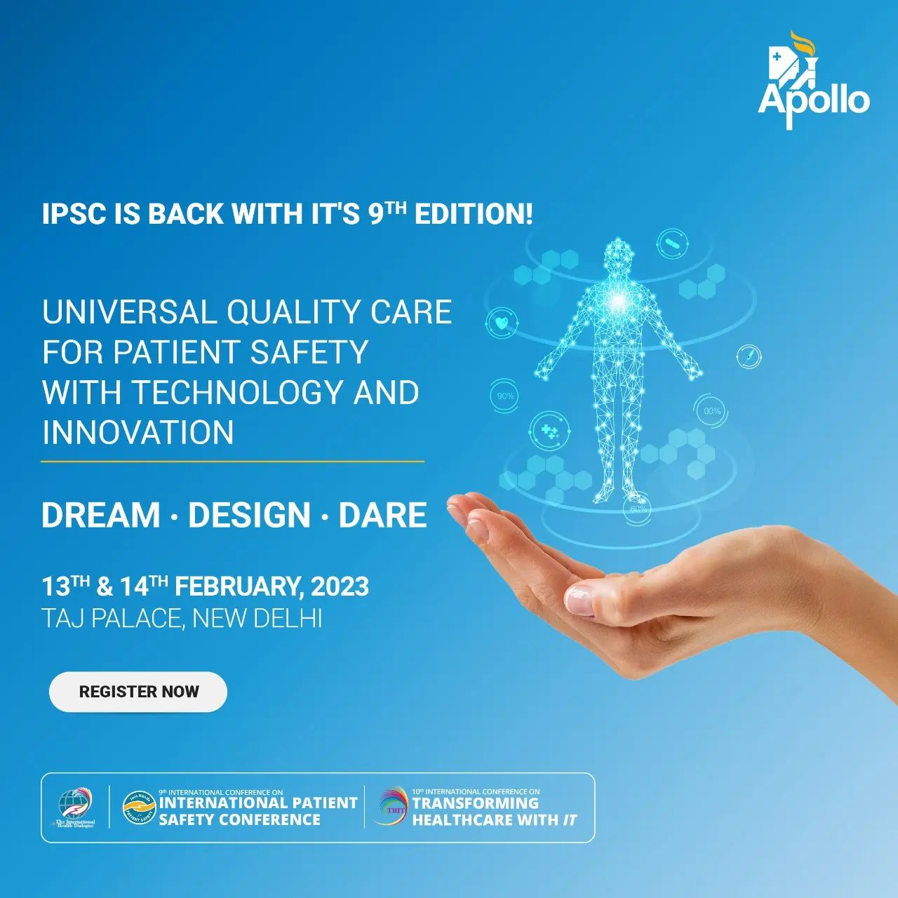
COMPANY/TOPIC for project: APOLLO Hospitals Brand Massaging: Healthcare market Example:
https://www.instagram.com/p/CnmoqyPvvfK/?igshid=MzRlODBiNWFlZA==

Slide 4
Part 1: Brand study, Competitor Analysis & Buyer’s/Audience’s Persona
Analyze Brand Messaging:
The product strategy and mix in Apollo Hospitals marketing strategy can be explained as follows:
Apollo Hospitals, a leading hospital in India, excels in the field of cardiology, oncology, knee replacement, diabetes treatment, neurology, etc. All these come under the product in the marketing mix of Apollo Hospitals. It employs robotics liked Da Vinci Robotics Surgical System, and Information Technology to ensure perfection in processes.
Examine the brand's tagline:
Touching lives
We are reckoned as the pioneers of the private healthcare industry in India.We have now forged into the international scene too, with high quality hospitals in Mauritius, Qatar, Oman &Kuwait.With ‘Touching lives’ as our slogan at Apollo, we are proud to say we have succeeded in touching lives of approximately 45 million people in over 120 countries.

Slide 5
Part 1: Brand study, Competitor Analysis & Buyer’s/Audience’s Persona
Competitor Analysis: Select three competitors operating in the same industry or niche as the chosen brand, examine their USPs and online communication.
Competitor 1: https://www.q1hospitals.com/
USP : Our department of general medicine is equipped to deal with any type of medical emergency and diagnosis.
Communication : The patient rights and responsibilities are given in the case sheet.
Competitor 2: https://www.carehospitals.com/
USP : Learn how USP contributes to heathcare quality and safety through standards of compounding
Communication : A clear explanation of proposed treatments and procedures, including
Competitor 3: https://www.kimshospitals.com/vizag-sheela-nagar/
USP : We offer a bouquet of comprehensive healthcare services across 25 specialties including cardiac sciences
Communication : To accept his/her willingness to be transferred to another hospital/ consultant.

Slide 6
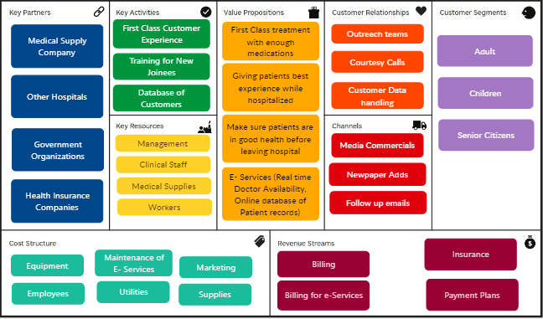
Part 1: Brand study, Competitor Analysis & Buyer’s/Audience’s Persona
Buyer's/Audience's Persona: Clearly define the target audience for the chosen brand. Consider demographics, psychographics, behaviors, and interests.
Apollo Hospital :

Slide 7
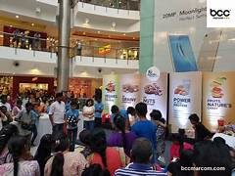
SEO Audit: https://www.apollohospitals.com/
Keyword Research:
Best treatment
New technology
Best equipments
Succes full surgerys
Best doctors
On page Optimization: B-
Your On-Page SEO could be better
Your page has some level of On-Page SEO optimization but could be improved further. On-Page SEO is important to ensure Search Engines can understand your content appropriately and help it rank for relevant keywords. You should ensure that HTML Tag Content is completed correctly and align text content to target keywords.

Slide 8
Individual Keywords
Keyword | Title | Meta Description Tag | Headings Tags | Page Frequency
apollo | ✔ | ✔ | ✔ | 49
hospitals | ✔ | ✔ | ✔ | 35
read | ✖ | ✖ | ✖ | 16
successfully | ✖ | ✖ | ✔ | 12
surgery | ✖ | ✖ | ✔ | 12
health | ✔ | ✔ | ✔ | 11
care | ✔ | ✔ | ✔ | 9
jul | ✖ | ✖ | ✖ | 9

Slide 9
Phrases
Phrase | Title | Meta Description Tag | Headings Tags | Page Frequency
apollo hospitals | ✔ | ✔ | ✔ | 19
jul 23 | ✖ | ✖ | ✖ | 9
cardiovascular symposium | ✖ | ✖ | ✔ | 6
hospital lucknow | ✖ | ✖ | ✖ | 6
apollomedics super specialty | ✖ | ✖ | ✔ | 6
navi mumbai | ✖ | ✖ | ✔ | 6
successfully treated | ✖ | ✖ | ✔ | 6
apollomedics super | ✖ | ✖ | ✔ | 6

Slide 10
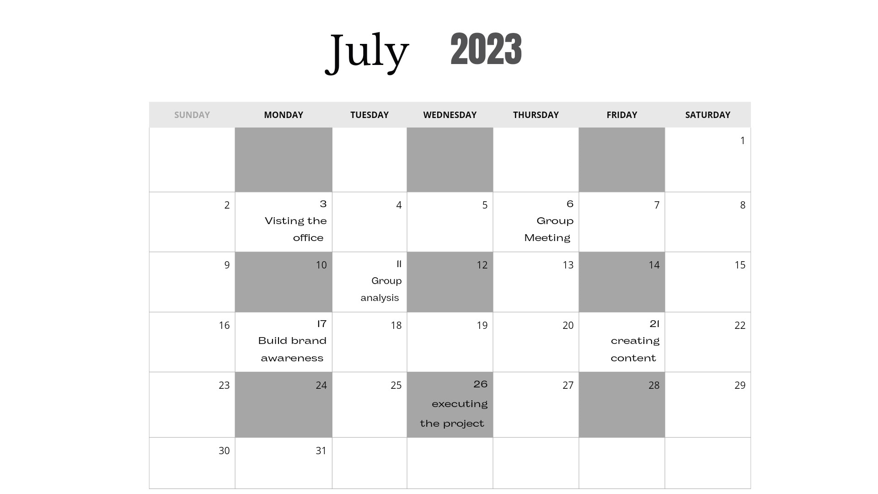

Slide 11
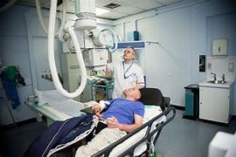
Part 3: Content Ideas and Marketing Strategies
Following is the distribution strategy in the Apollo Hospitals marketing mix:
Apollo Hospitals is present in most tier one and tier two cities. It has different types of models like Apollo Clinic, Apollo Reach Hospitals, Apollo Cradle, etc. Apollo Reach Hospitals cater relatively backward places. Apollo Cradle is for childcare. Such different models help Apollo Hospitals ensure its presence in all fields of medicine.
Apollo is both accessible and available in multiples cities and Muscat and Dhaka outside of India.

Slide 12

Part 4: Content Creation and Curation (Post creations, Designs/Video Editing, Ad Campaigns over Social Media and Email Ideation and Creation)
Post Creation:
Select Content Categories: Identify three different content formats relevant to the chosen topic or industry. Research and Brainstorm: Research trending topics, industry news, or audience interests within each category. Brainstorm ideas for social media posts that align with each category. Do note that 1 content format has to be video and additionally 3 stories/status are to be created.
Format 1: Blog article
Format 2: Video
Format 3: Creative

Slide 13

Part 4: Content Creation and Curation (Post creations, Designs/Video Editing, Ad Campaigns over Social Media and Email Ideation and Creation)
Format 1: Blog article
Aim: enables community engagement and offers relevant health and wellness information at no cost.
Date: 20th July 2023
Idea: Get the latest healthcare updates and articles from Apollo Hospitals Information Center, one of the top hospitals in India.
Topic: Awareness of doctors and hospitals

Slide 14

Part 4: Content Creation and Curation (Post creations, Designs/Video Editing, Ad Campaigns over Social Media and Email Ideation and Creation)
Format 2: Video
Aim: Watch Ahsan sharing his experience of safe and secure surgery at Indraprastha Apollo Hospitals
Date: 22nd July 2023
Idea: Awareness of Apollo hospitals
Topic: Technology of hospitals

Slide 15
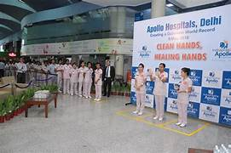
Part 4: Content Creation and Curation (Post creations, Designs/Video Editing, Ad Campaigns over Social Media and Email Ideation and Creation)
Format 3: Creative
Aim: India’s largest for-profit health care system, working closely with national, state, and local government authorities, undertook a multifaceted approach to handle the Covid-19 pandemic.
Date: 25th July 2023
Idea: To attract more custmores
Topic: customer satification

Slide 16
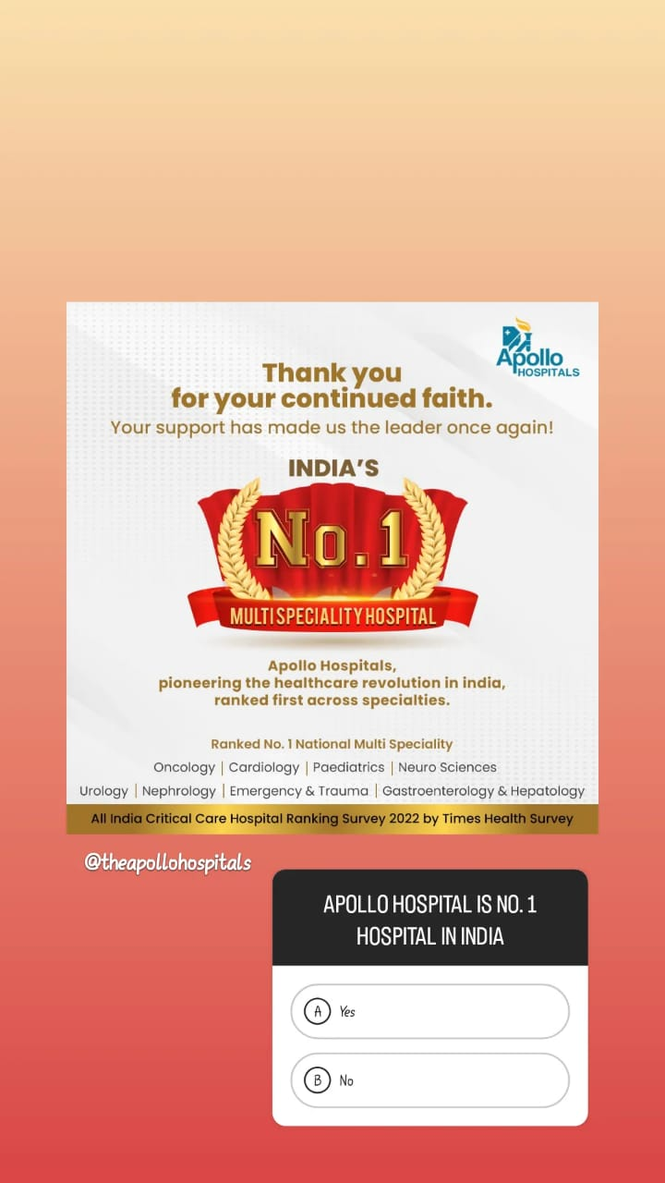
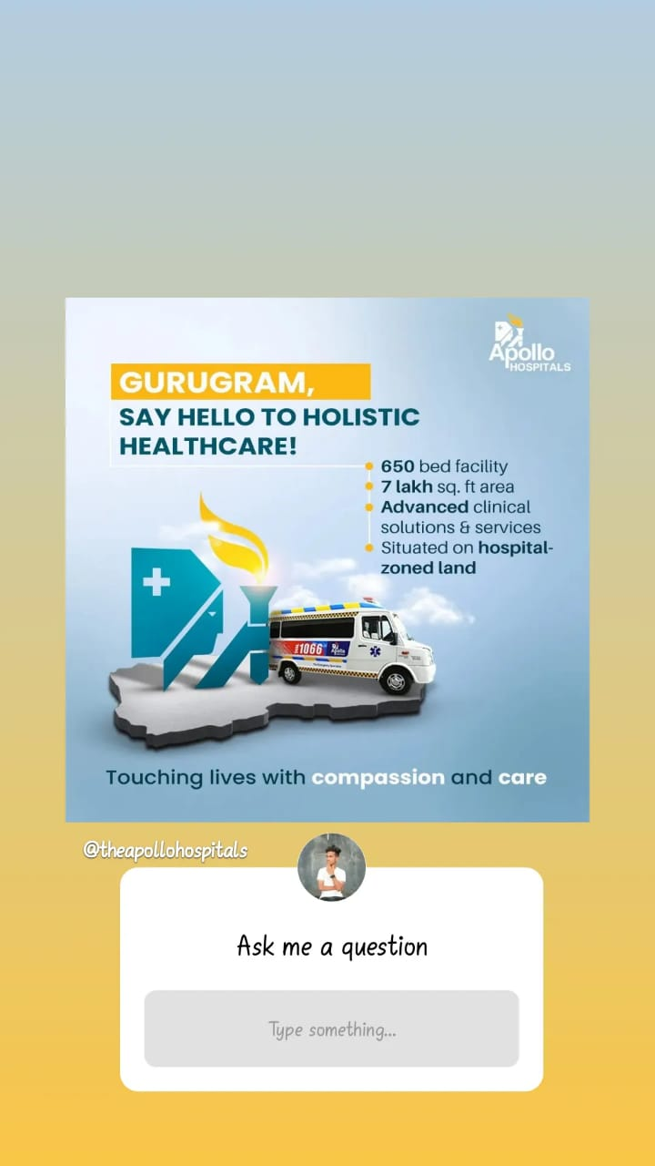
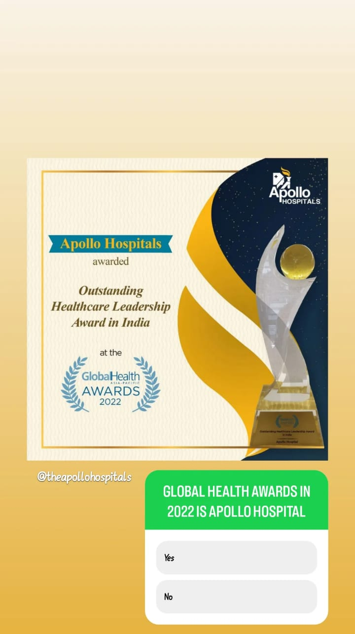
Instagram Story

Slide 17

Designs/Video Editing

Slide 18
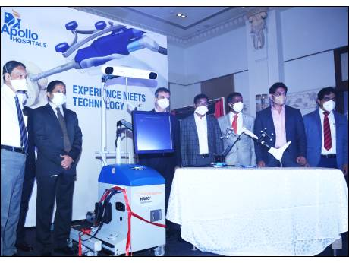
Part 4: Content Creation and Curation (Post creations, Designs/Video Editing, Ad Campaigns over Social Media and Email Ideation and Creation)
Social Media Ad Campaigns
Ad Campaigns over Social Media:
Come up with 3 ad campaigns each covering one of the mentioned goals: brand awareness, driving website traffic, or generating leads

Slide 19
Part 4: Content Creation and Curation (Post creations, Designs/Video Editing, Ad Campaigns over Social Media and Email Ideation and Creation)
For every campaign clearly define:
Advertising Goals: Marketing Strategy of Apollo Hospitals analyzes the brand with the marketing mix framework which covers the 4Ps (Product, Price, Place, Promotion). These business strategies, based on Apollo Hospitals marketing mix, help the brand succeed in the market. Let us start the Apollo Hospitals Marketing Strategy & Mix to understand its product, pricing, advertising & distribution strategies.
Audience Targeting: Define the target audience for the ad campaigns based on demographics, interests, and behavior.
Ad Creation: Create visually appealing ad creatives, compelling ad copy and relevant call-to-action.

Slide 20
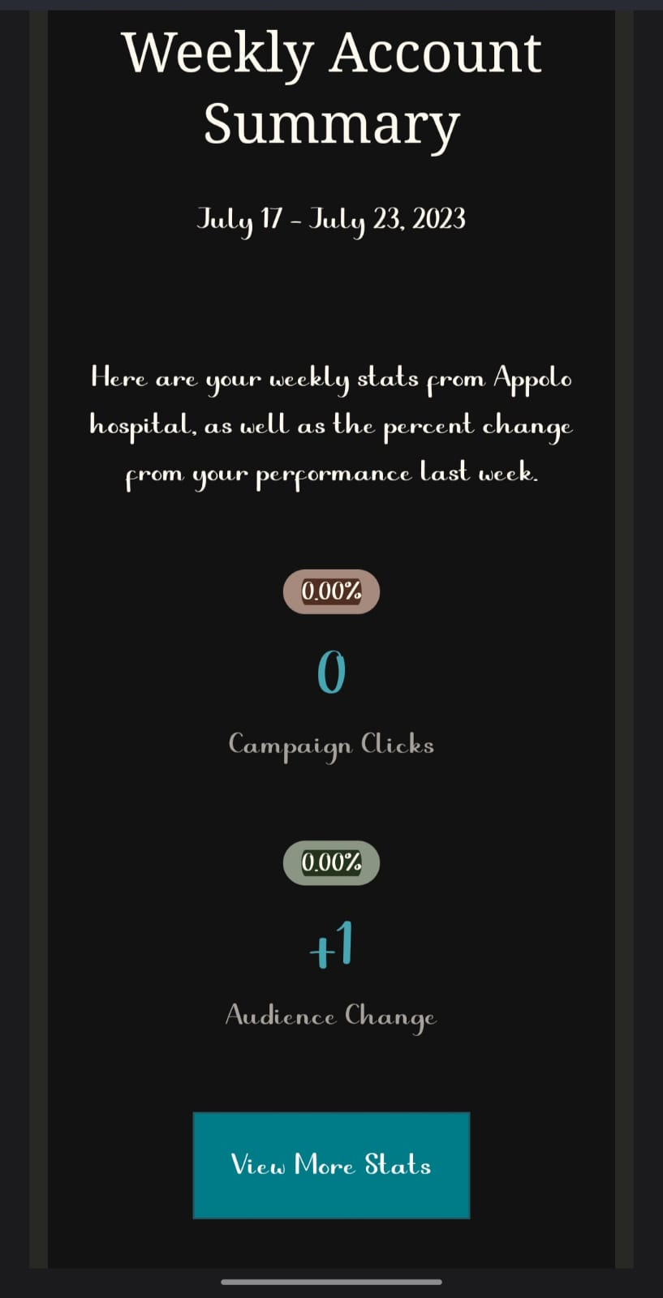
Email Ad Campaign 2 - Lead Generation
(insert emailer image)

Slide 21

Part 4: Content Creation and Curation (Post creations, Designs/Video
Editing, Ad Campaigns over Social Media and Email Ideation and Creation)
Reflect on the content creation and curation process, discussing the challenges faced and lessons learned.
To attract the more customer to visit the apollo hospital.

